Slide 1
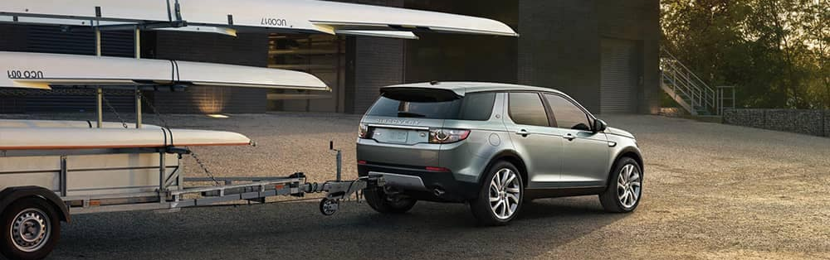
Lateral Control Passenger Cars with Trailer
Analytical model of vehicle-trailer combination
ADAS

Slide 2
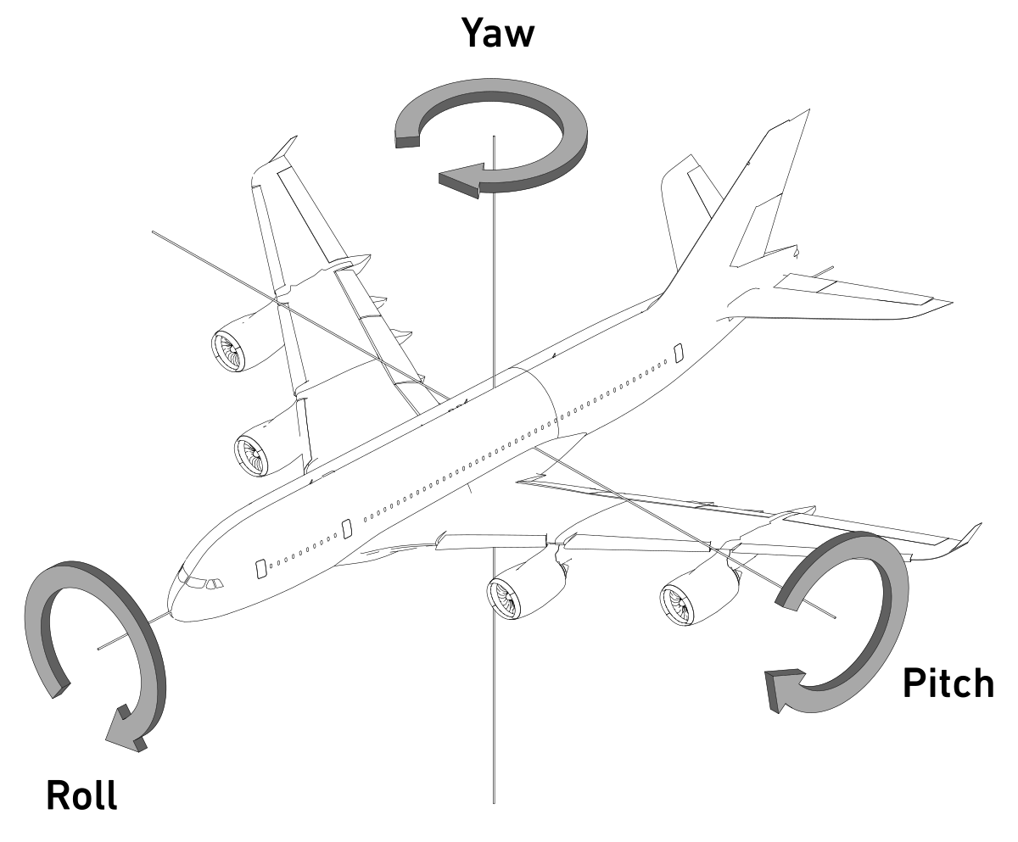












Analytical model of vehicle-trailer combination
For the propouse of studyng the yaw plane dynamics of the vehicle-trailer conbination, a single track (mean bicycle description) 4-th order model ilustraited in Figure 1.
x
$$l_{1}$$
$$l_{2}$$
$$a_{2}$$
$$m_{1}, I_{z1}$$
$$δ$$
$$b_{2}$$
$$θ$$
$$m_{2}, I_{z2}$$
$$e_{1}$$
$$b_{1}$$
$$a_{1}$$
$$c_{1}$$
y
Notes:
Reference:
Stability and Control Considerations of Vehicle-Trailer Combination / Aleksander Hac, Daniel Fulk Hsien Chen
Delphi Corporation
Introduction:
Handling behavior of articulated vehicles is more complex and less predictable than that of non-articulated vehicles. This poses challenge to on-expert drives of light vehicles, who occasionally tow recreational trailers and may not have good understanding of dynamics complexity of vehicle-trailer combination.
The task of controlling vehicles becomes the most difficult when system becomes unstable.
The articulated vehicle may experience two types of instability in the yaw plane. The first one is a divergent instability such as jackknifing, in which the hitch angle increases without experiencing oscillations.
This occurs when, at a particular operating conditions becomes negative and the speed is above critical velocity.
Jackknife example: https://www.youtube.com/watch?v=EIHrzcrB_3E
The second type is dynamics in nature and may lead to oscillatory response with increasing amplitude known as shaking or sway.
https://www.youtube.com/watch?v=6mW_gzdh6to
Justification:
Since no direct feedback information about the trailer motion or even knowledge of trailer parameters is one of the most important issues for system intended for production

Slide 3
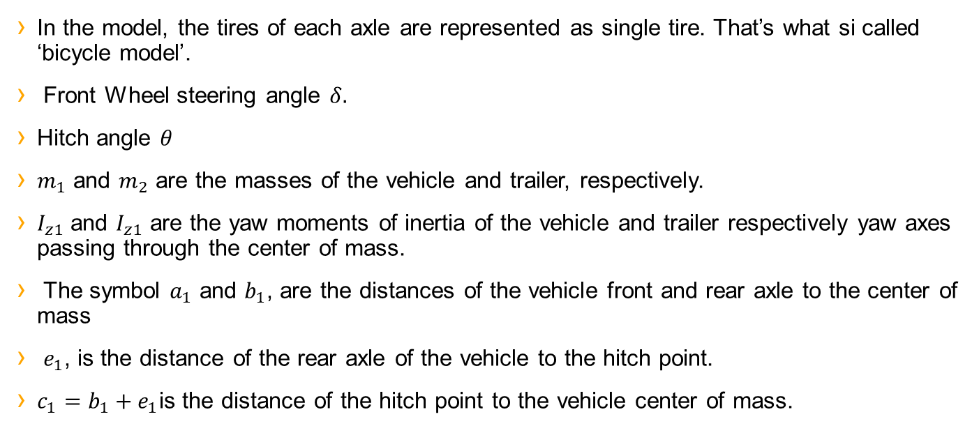
In the model, the tires of each axle are represented as single tire. That’s what si called ‘bicycle model’.
Front Wheel steering angle $δ.$
Hitch angle $θ$
$m_{1}$ and $m_{2}$ are the masses of the vehicle and trailer, respectively.
$I_{z1}$ and $I_{z1}$ are the yaw moments of inertia of the vehicle and trailer respectively yaw axes passing through the center of mass.
The symbol $a_{1}$ and $b_{1}$, are the distances of the vehicle front and rear axle to the center of mass
$e_{1}$, is the distance of the rear axle of the vehicle to the hitch point.
$c_{1}=b_{1}+e_{1}$is the distance of the hitch point to the vehicle center of mass.
Notes:
Front wheel steering angle, hitch angle and tire slip angles are assumed to be small, even tire slip angles could be considered as zero.
In addition, the force of aerodynamics are ignores (that’s mean considered system as flat vehicle or depreciable high).

Slide 4
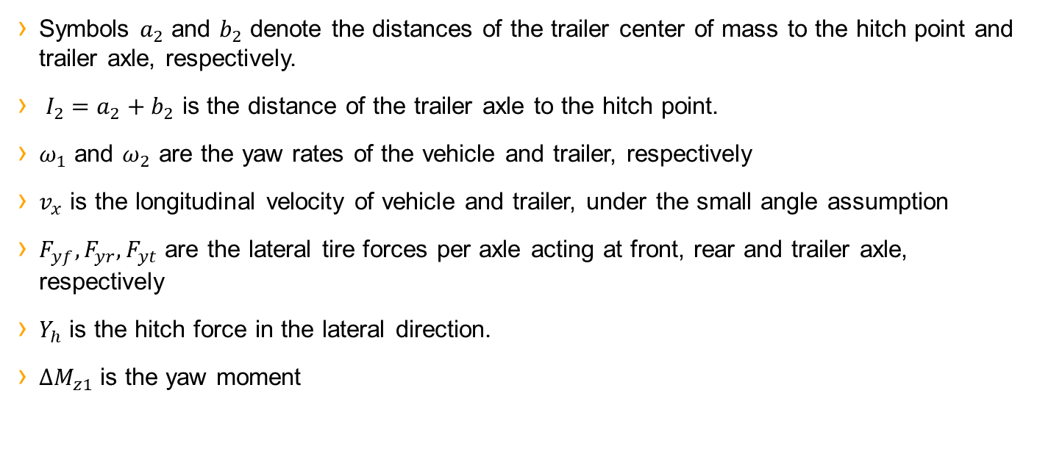
Symbols $a_{2}$ and $b_{2}$ denote the distances of the trailer center of mass to the hitch point and trailer axle, respectively.
$I_{2}=a_{2}+b_{2}$ is the distance of the trailer axle to the hitch point.
$ω_{1}$ and $ω_{2}$ are the yaw rates of the vehicle and trailer, respectively
$v_{x}$ is the longitudinal velocity of vehicle and trailer, under the small angle assumption
$F_{yf}, F_{yr}, F_{yt}$ are the lateral tire forces per axle acting at front, rear and trailer axle, respectively
$Y_{h}$ is the hitch force in the lateral direction.
$∆M_{z1}$ is the yaw moment

Slide 5
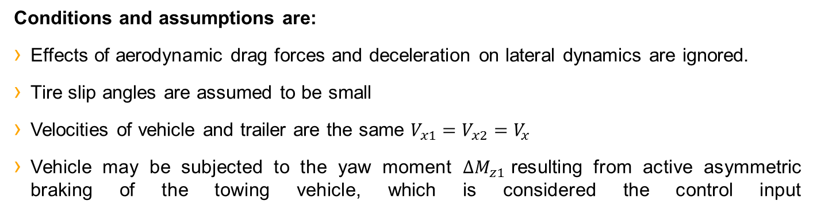
Dynamic equations
Conditions and assumptions are:
Effects of aerodynamic drag forces and deceleration on lateral dynamics are ignored.
Tire slip angles are assumed to be small
Velocities of vehicle and trailer are the same $V_{x1}=V_{x2}=V_{x}$
Vehicle may be subjected to the yaw moment ${∆M}_{z1}$resulting from active asymmetric braking of the towing vehicle, which is considered the control input

Slide 6


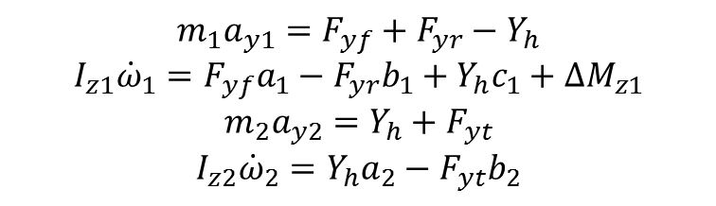










Dynamic equations
The equations of lateral and yaw motions of the vehicle and trailer are:
x
$$m_{1}a_{y1}=F_{yf}+F_{yr}−Y_{h}$$
$$I_{z1}{\dot{ω}}_{1}=F_{yf}a_{1}−F_{yr}b_{1}+Y_{h}c_{1}+∆M_{z1}$$
$$m_{2}a_{y2}={Y_{h}+F}_{yt}$$
$$I_{z2}{\dot{ω}}_{2}=Y_{h}a_{2}−F_{yt}b_{2}$$
$$l_{1}$$
$$l_{2}$$
$$a_{2}$$
$$m_{1}, I_{z1}$$
$$δ$$
$$b_{2}$$
$$θ$$
$$m_{2}, I_{z2}$$
$$e_{1}$$
$$b_{1}$$
$$a_{1}$$
$$c_{1}$$
y
$a_{y1}$ y $a_{y2}$are the lateral accelerations at the vehicle and trailer centers of mass

Slide 7
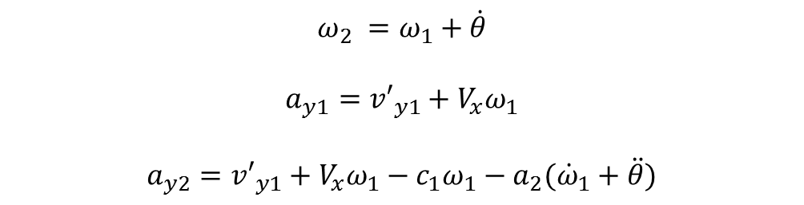
Dynamic equations
The following are valid equalities
$$ω_{2} =ω_{1}+\dot{θ}$$
$$a_{y1}={v′}_{y1}+V_{x}ω_{1}$$
$$a_{y2}={v′}_{y1}+V_{x}ω_{1}−c_{1}ω_{1}−a_{2}({\dot{ω}}_{1}+\ddot{θ})$$

Slide 8
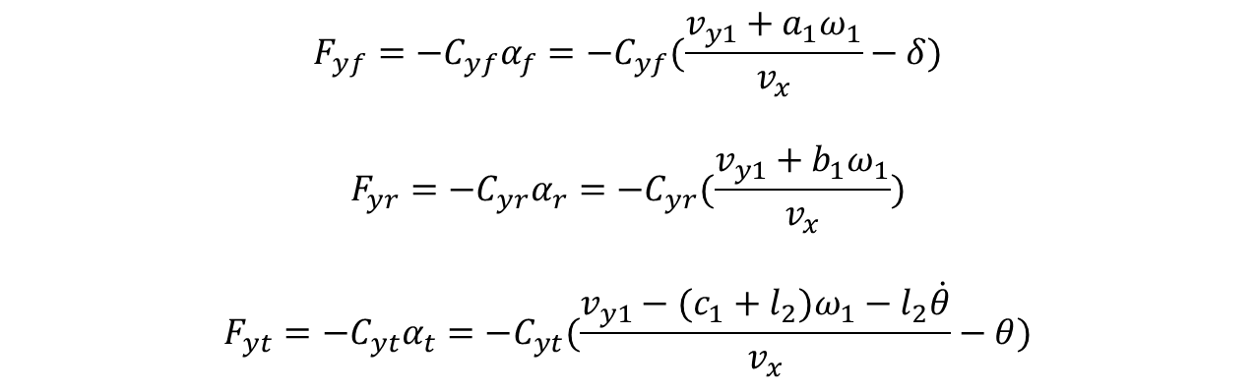
Dynamic equations
$$F_{yf}=−C_{yf}α_{f}={−C}_{yf}(\frac{v_{y1}+a_{1}ω_{1}}{v_{x}}−δ)$$
$$F_{yr}=−C_{yr}α_{r}={−C}_{yr}(\frac{v_{y1}+b_{1}ω_{1}}{v_{x}})$$
$$F_{yt}=−C_{yt}α_{t}={−C}_{yt}(\frac{v_{y1}−{(c_{1}+l}_{2})ω_{1}−l_{2}\dot{θ}}{v_{x}}−θ)$$
The tire forces per axle are assumed to be proportional to the tire slip angles
$C_{yf}$, $C_{yr}$,and $C_{yt}$ are the cornering stiffnes values for the tires

Slide 9
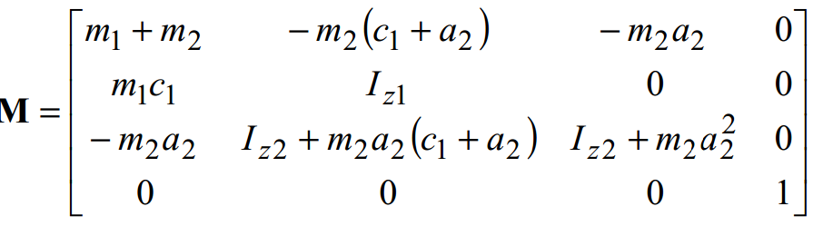
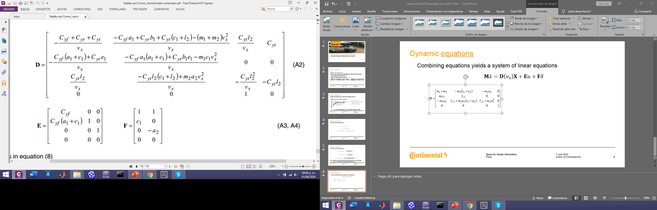


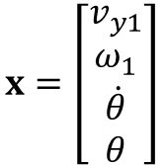
Dynamic equations
Combining equations yields a system of linear equations
$$M\dot{x}=D\left(v_{x}\right)x+Eu+Fδ$$
$$x=\left[\begin{aligned}v_{y1} \\ ω_{1} \\ \dot{θ} \\ θ\end{aligned}\right]$$
$$u=∆M_{z1}$$

Slide 10

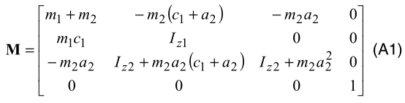
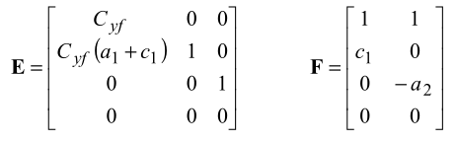
System of linear equations to the vehicle-trailer combination
The system written in a matrix form is:
Matrices M, E y F are constant

Slide 11
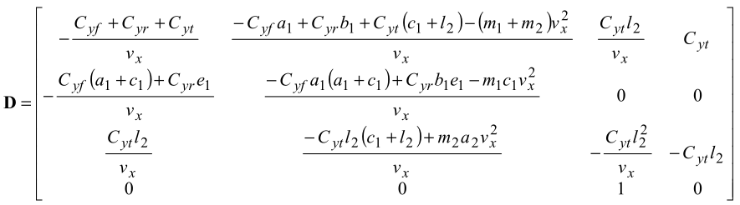

Matrix D is a function of the vehicle speed
The state vector, x, and the control input, u, are given by
,

Slide 12
By pre-multiplying system of linear equations on both sides by , the state equation is obtained
Where

